Slide 1
Content delivery networks
Antoni Bertel

Slide 2
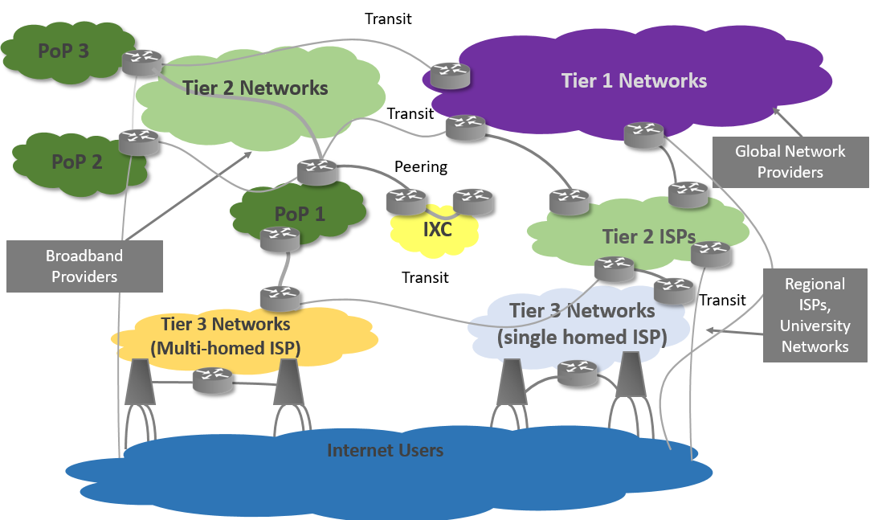
Internet is complex

Slide 3
Challenges
Distance
Network bottlenecks
Packet loss
Congestion
TCP slow start
Round-trip delay time
Retransmission
Chatty protocol

Slide 4
CDN - content Delivery Network
Content Delivery Networks (CDN), which evolved first in 1998, replicate content over several mirrored (surrogate) Web servers strategically placed at various locations in order to deal with the flash crowds. Geographically distributing the Web servers’ facilities is a method commonly used by service providers to improve performance and scalability.
Flash crowds is a 1973 English novella. In network is a sudden, large surge in traffic to a particular WEB resource.

Slide 5
CDN - content Delivery Network
1st Generation: Focused on Static of Dynamic Web Documents
2nd Generation: Focused on Video-on-Demand, audio and video streaming.

Slide 6
CDN - Why it is done?
Accelerated Web Performance - CDNs help to improve the delivery of website content (static and dynamic) so that websites perform better, load faster, and generate more revenue for content providers.
Software Updates and Downloads - CDNs enhance the automatic or on-demand delivery of software or file downloads, including software patches.
Rich Media Content Streaming - CDNs help deliver rich media content, that is, interactive digital media such as audio and video files in different encoding formats (HTTP adaptive streaming, Adobe HDS, and Apple HLS, etc.), to specialized streaming clients and devices of end-users.

Slide 7
CDN - Why it is done?
IPTV Use Case - CDNs are used for Internet Pay TV (IPTV), such as catch-up TV service for recent programs of broadcasters,as well as online live video channels.
Managing and Delivering User-Generated Content - CDNs are often used to facilitate the hosting and distribution of user-generated content. YouTube is the prime example where a CDN is used to deliver content uploaded by end-users.
End-to-End Online Video - CDNs at its fullest use are often employed as the glue in integrating online video and content management platform to create an end-to-end delivery chain,offering a real differentiation through high quality user experience.

Slide 8
Target Audience
Networking companies
Data center providers
Cloud Service Providers (CSPs)
Internet Service Providers (ISPs)
Telecom providers
Value Added Resellers (VARs)
Managed Service Providers (MSPs)
Hosting vendors

Slide 9
Market segments
E-commerce and Consumer Products/Retail - CDN soffer whole-site and dynamic content delivery services to website owners. A large portion of such websites is composed of applications and dynamic content, such as e-commerce/online retailers (eBay, Amazon), auction website (graysonline), and consumer products website
Media and Entertainment - . CDNs offer progressive download, linear, VoD, and live streaming services to digital media companies such as content broadcasters (CNN, BBC), Internet-based publishing (Fairfax Media), and experimental digital media.

Slide 10
Market segments
Hospitality, Travel, and Leisure - This market segment features websites and services used by end-users for accommodation booking, holiday booking, air ticket purchase, and so on.
Banking, Financial Services, and Insurance - CDNs help this market segment by delivering a large amount of static website content, as well as dynamic content and applications, such as currency exchange, financial projections, and loan calculators.
Public Sector/Government and Enterprise - CDNs also help the Government (such as the president.gov.by) to deliver heavy websites of secure and static content.

Slide 11
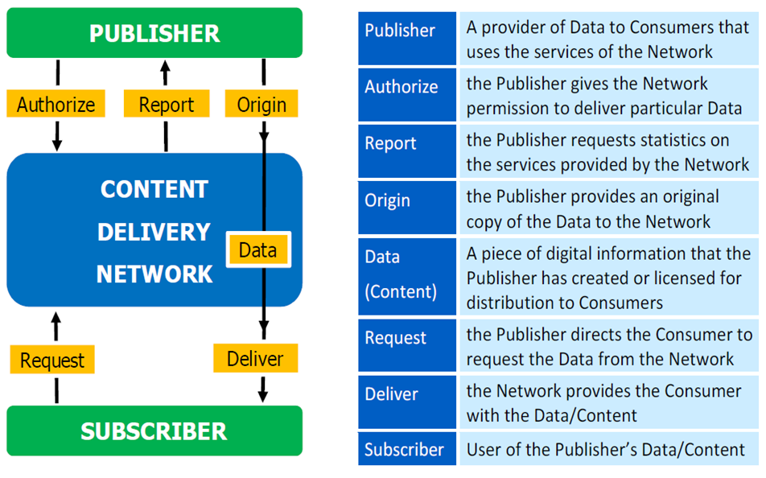
CDN architecture

Slide 12
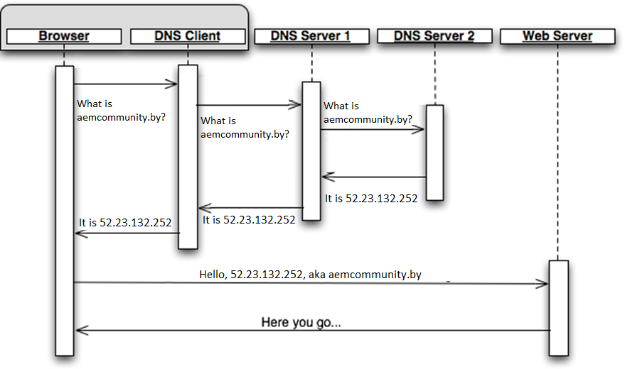
DNS-normal routing

Slide 13
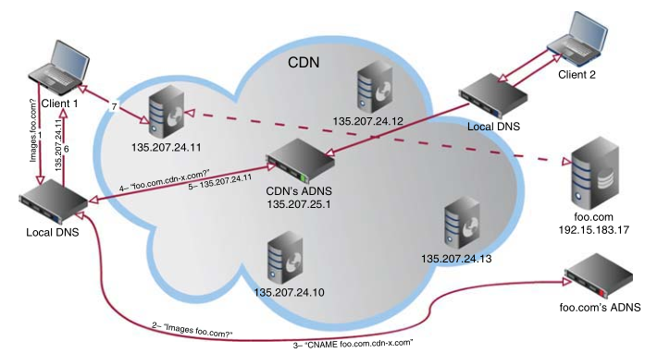
DNS-based request routing
Once a DNS query for an outsourced URL arrives at the CDN’s ADNS,
The CDN provider can direct different HTTP requests to different content servers,
by returning different IP addresses to different queries.

Slide 14
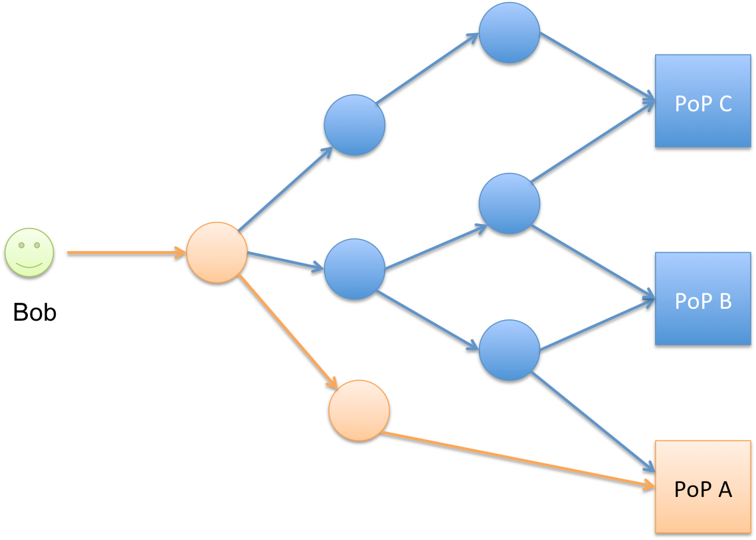
Request Routing Using IP Anycast
The same IP address is assigned to multiple endpoints,
and packets to this IP address are routed to the endpoint that is the nearest to the sender based on the shortest (or otherwise most preferred) path from the network-routing perspective

Slide 15
CDN overlays
Increases the security and mitigates distributed denial of service (DDoS) attacks on websites and other online services
Provides wide-area communication with more reliability, lesser latency, and greater throughput than the public Internet can
Deliver websites, on-demand videos, music downloads, software downloads, and other forms of online content
Security overlay
Routing overlay
Caching overlay

Slide 16
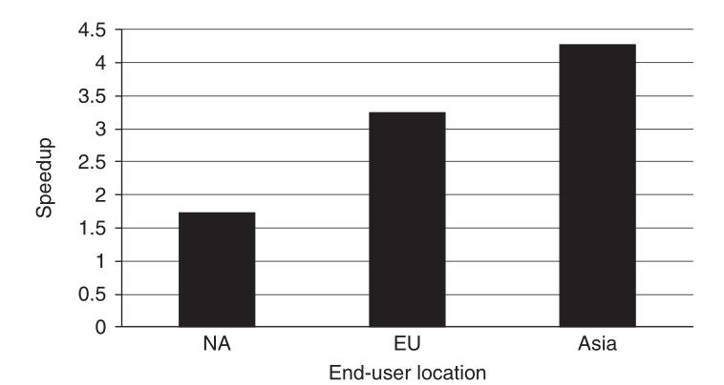
Performance benefits of a caching overlay

Slide 17
Analytic overlay
Know It All - Access constantly updated information about server performance, user demographics, and bandwidth utilization
Know It Now - With live events, often there is no time to wait for server log processing. Use real-time statistics and take action—in the moment.
Understand the Audience - See how users are interacting with the website content, where they are coming from, and how long they stick around

Slide 18

What exactly should be distributed?
The user behavior when requesting data and services on the Internet is following Zipf-like distributions, which concentrate a major portion of activity on a small subset of the most popular items. Such behavior makes it efficient to distribute popular data over caches and servers even of limited size and to deliver data from many sources that are located closer to the user.
𝛼 = A(1) is the maximum number of requests observed for an item in the statistic, A(R) is the number of requests to an item, R - rank of item, β - exponent, calculated using least squares method

Slide 19
Cache replacement Strategies
First In First Out (FIFO)
Last In First Out (LIFO)
Least Recently Used (LRU)
Most Recently Used (MRU)
Pseudo-LRU (PLRU)
Random Replacement (RR)
Segmented LRU (SLRU)
LFU with Dynamic Aging (LFUDA)
Low Inter-reference Recency Set (LIRS)
Adaptive Replacement Cache (ARC)
Clock with Adaptive Replacement (CAR)
Multi Queue (MQ) caching algorithm|Multi Queue (MQ)

Slide 20
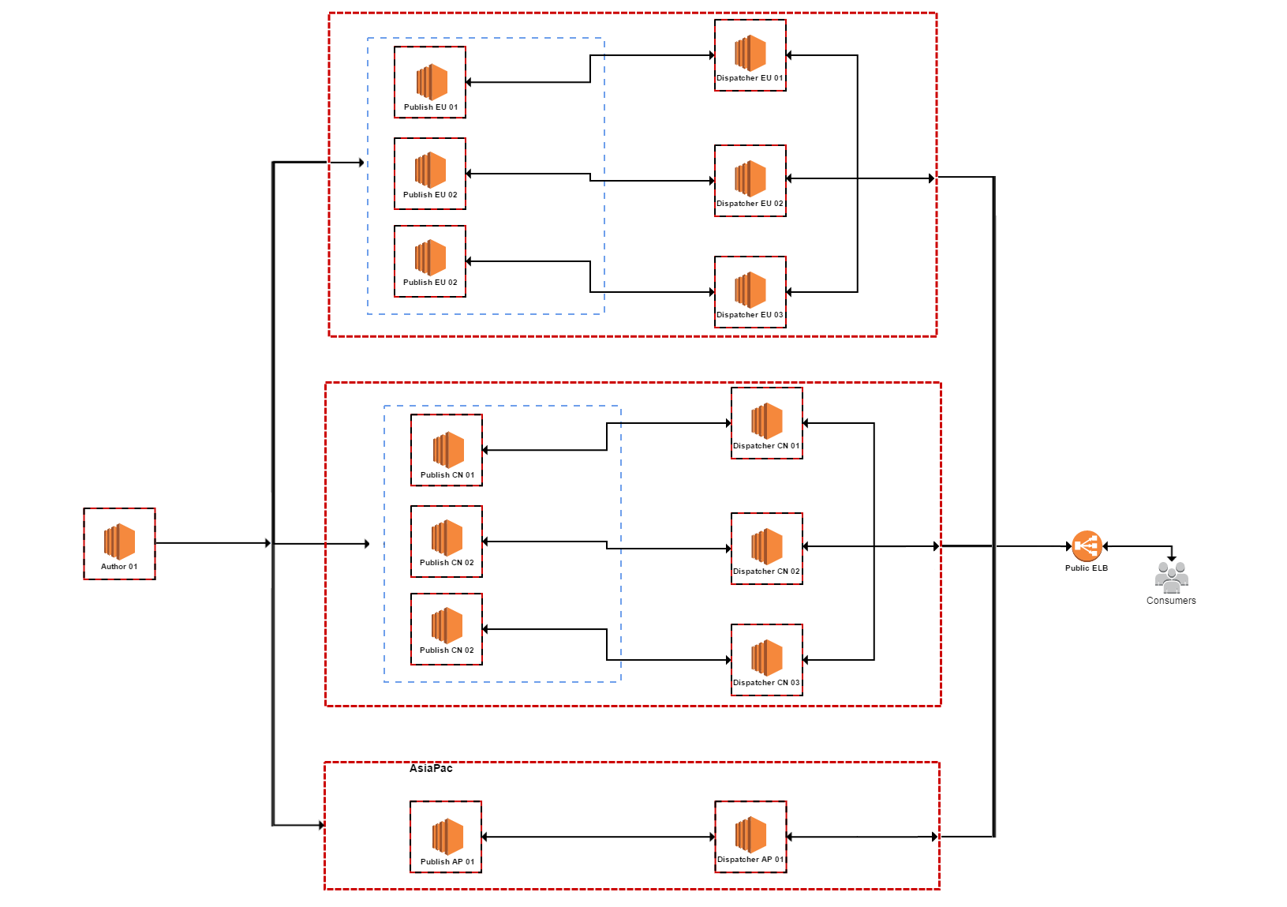
Custom CDN
Europe
Cache
Issues
Network bottlenecks
Heavy scaling
Losing money
Long-Running Request-Response
China
Analytic
Routing
Asia
Security

Slide 21
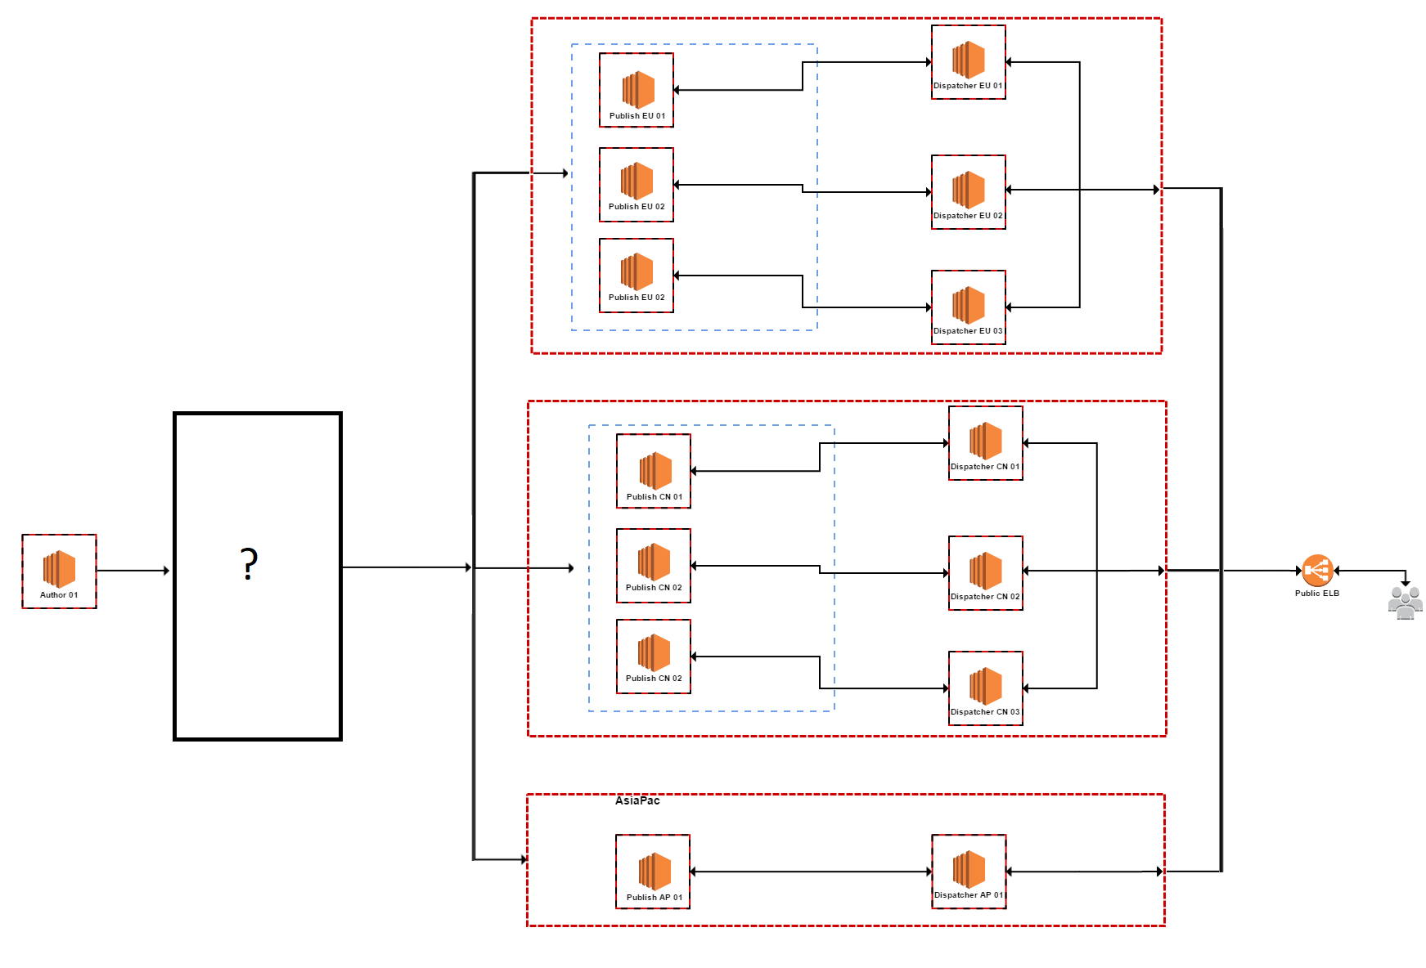
Solution

Slide 22
See in action

Slide 23
See in action

Slide 24







Cloud solitons

Slide 25
Care about
Uptime/availability of service
Throughput performance
First byte delivery time
Reporting/analytics
Range of products (Analytic, Dynamic Tag Management, etc.)
Customer service

Slide 26
Question Time

